Slide 1
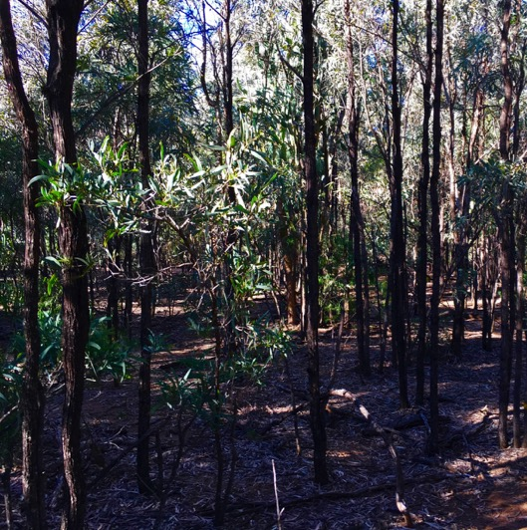
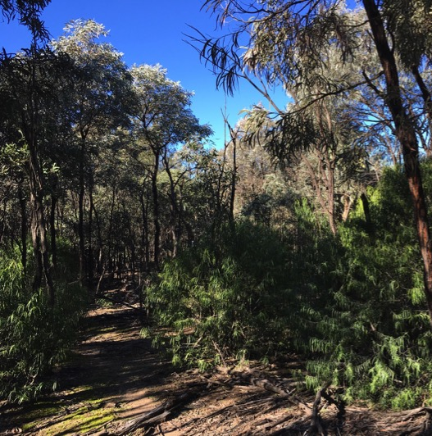
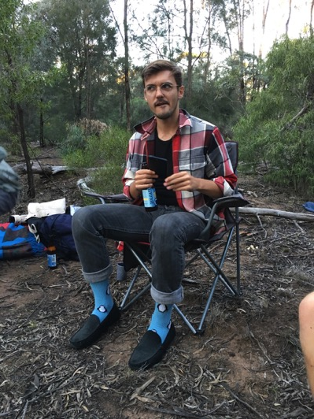
Designing rigorous surveys and experiments: CONTROL!!!
Control
Thinned
Out of Control!!!
Dr John Dwyer CONS7008

Slide 2
Strength of inference
Ability to draw conclusions about our POPULATION of interest from a SAMPLE
Ability to explain observed pattern and rule out alternatives
requires CONTROLS, randomisation, and replication

Slide 3
Four main approaches
Conceptual models
Observational studies
Descriptive
Quantitative (using empirical models)
Mathematical models
Experiments

Slide 4
How do we achieve control in observational studies??
Test multiple hypotheses!
Often many plausible explanations for an observed pattern (even in situations where there is only one ‘true’ causal factor)
Often multiple contributors to an observed pattern
Inference is strengthened by designing studies that evaluate multiple “potential contributors” (multiple hypotheses)

Slide 5
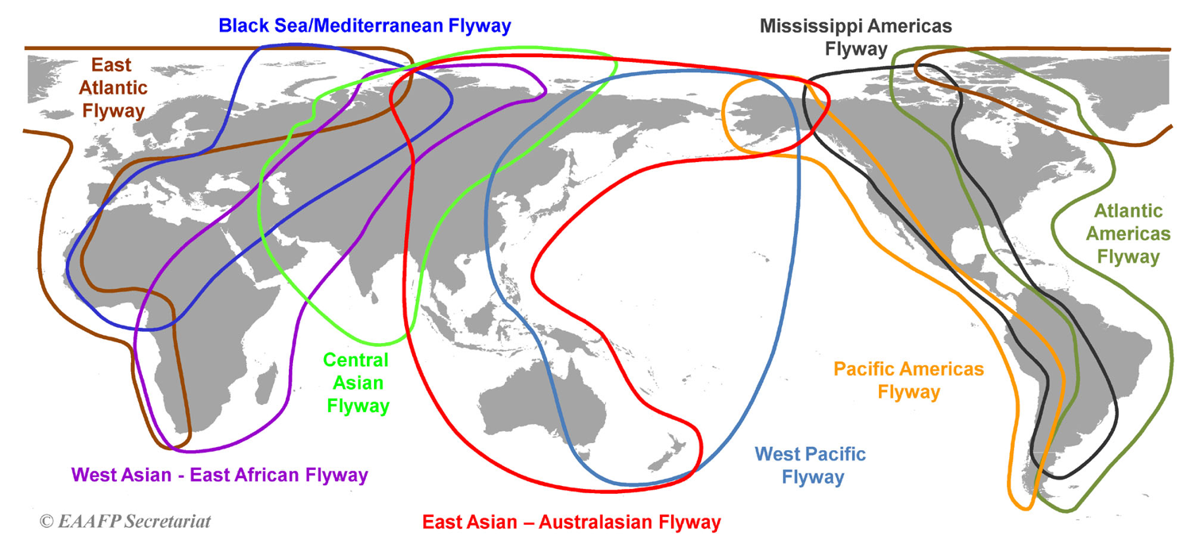
Drivers of shorebird declines

Slide 6
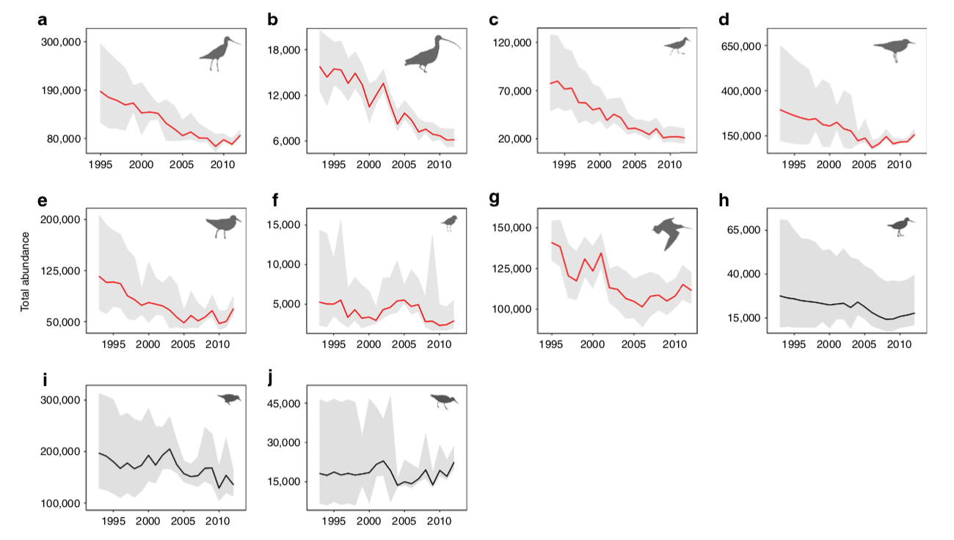
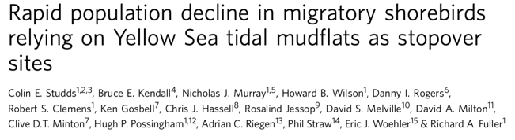
Drivers of shorebird declines

Slide 7
Drivers of shorebird declines
We need information on migratory shorebird species that are declining, and those that are not
WHY???

Slide 8
Drivers of shorebird declines
We need associated information that might explain species’ trends (alternative hypotheses)
Migration distance
Breeding range size
Generation time
Body size
Yellow sea reliance (how much does the species rely on the Yellow Sea tidal flats for successful migration)

Slide 9
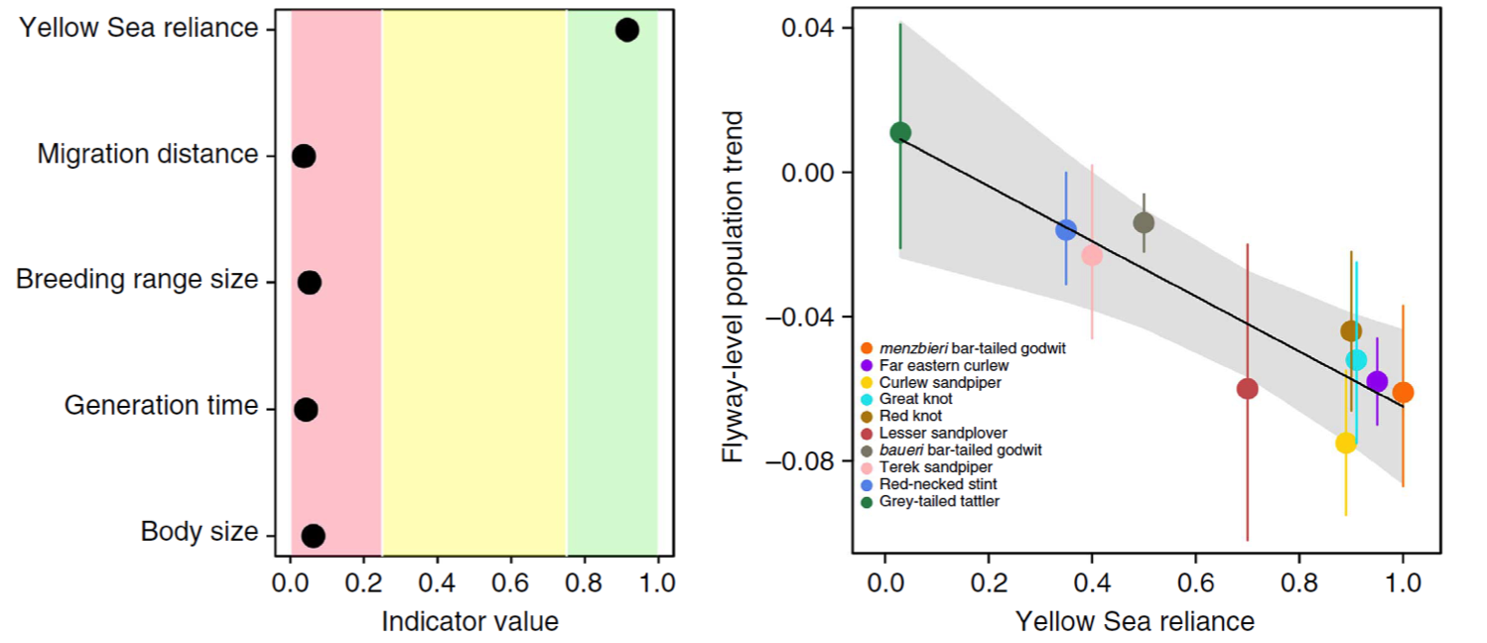
Drivers of shorebird declines
Studds et al. 2017 Nature Comms

Slide 10
Drivers of shorebird declines
So these results are correlational, but…
Our inferences are very strong because of the excellent design and use of multiple hypotheses!!!

Slide 11
Why are we not evaluating multiple hypotheses?
“…scientists usually ‘fall in love’ with their favourite hypothesis, leading to the unfortunate practice of trying to fit all evidence into a single explanation instead of finding genuine explanations for the phenomenon they study.”
Only 21/100 randomly selected studies* from the ecological and evolutionary literature tested more than one hypothesis…
* Sampled from Ecology, Ecology Letters, Molecular Ecology, Evolution and Global Change Biology (between 2001 to 2011)
Betini et al. 2017 Royal Soc. Open Sci.

Slide 12
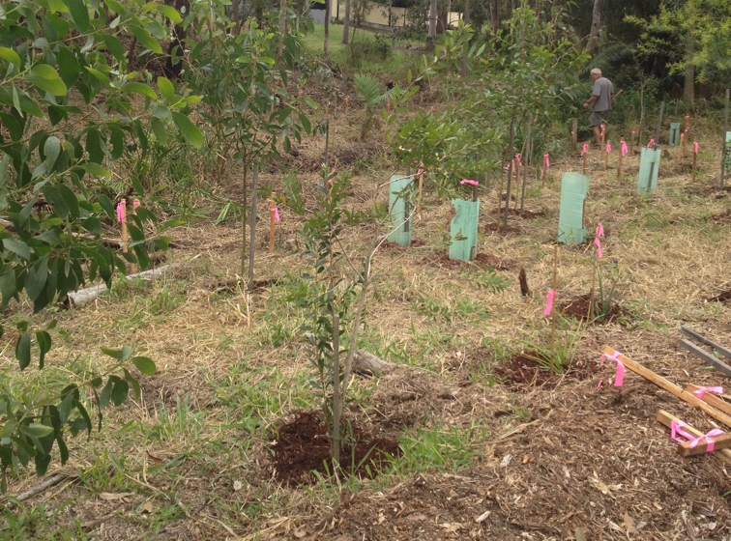
Let’s work through an example!
Question: Why do restoration plantings in southeast QLD vary in their rates of carbon sequestration?

Slide 14
How do we achieve control in mathematical modelling studies??
Easy!
Run the model with different parameter values and see what happens
Depends on the type of model and associated complexity

Slide 15
Example – Does thinning accelerate recovery of brigalow forest biomass?
Control
Thinned

Slide 16
Example – Does thinning accelerate recovery of brigalow forest biomass?

Slide 17
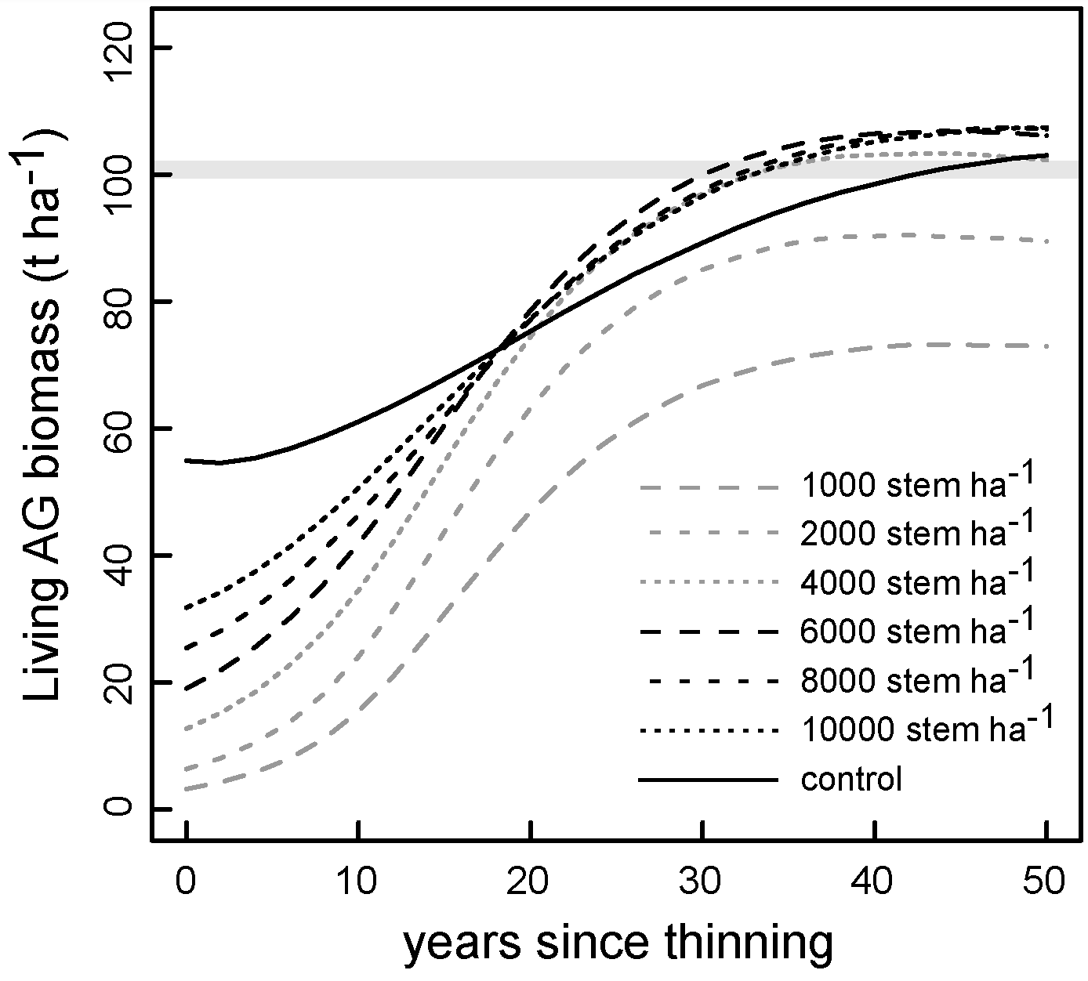
Example – Does thinning accelerate recovery of brigalow forest biomass?

Slide 18
How do we achieve control in experimental studies??
We use…CONTROLS!!!
to eliminate the possibility that the observed response (or pattern) arose from reasons other than the treatment (or by chance).
Provides a reference condition (“counterfactual”) and understanding of normal variability.

Slide 19
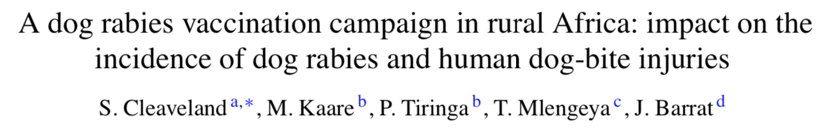
Dog rabies vaccination
In the Serengeti (Africa):
1996-2001, four dog vaccination campaigns conducted in villages
Vaccination coverage of the dog population estimated as 60-74%

Slide 20
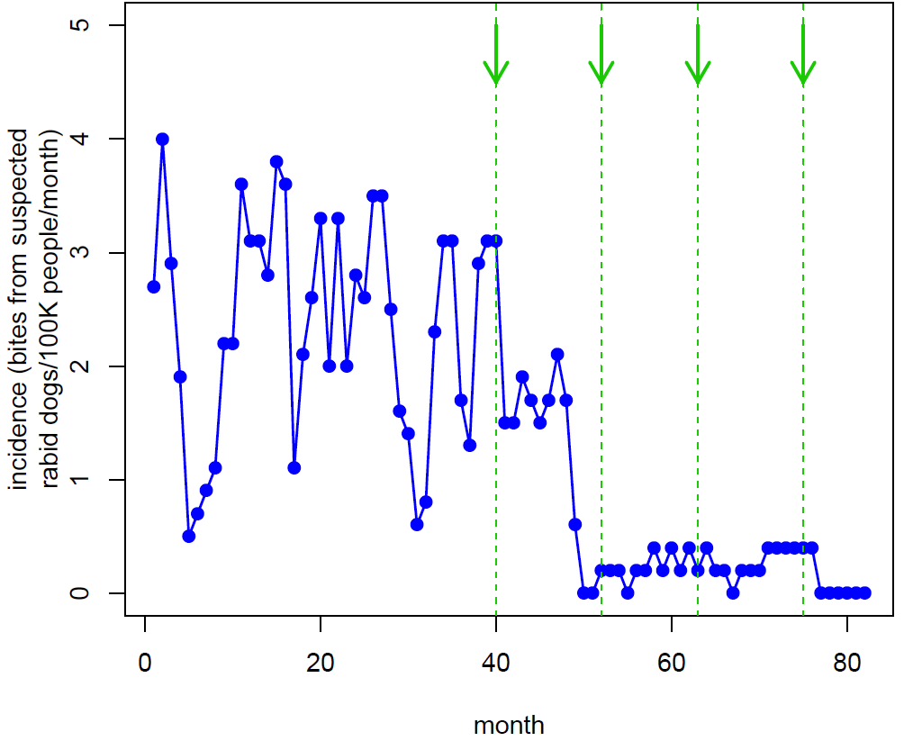
Dog rabies vaccination
Cleaveland et al. 2003 Vaccine

Slide 21
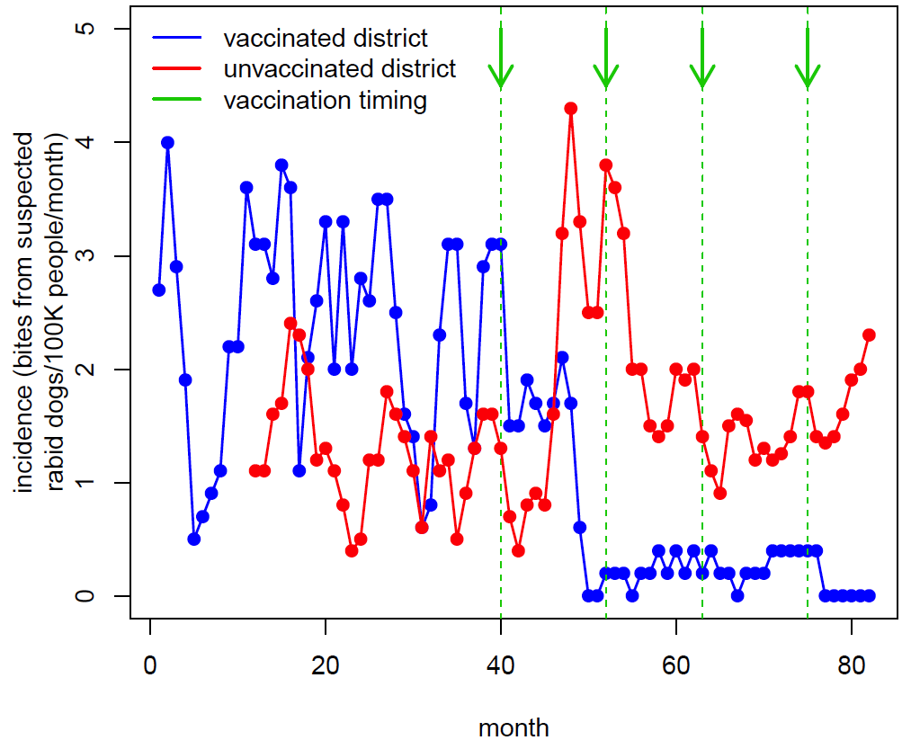
Dog rabies vaccination
Cleaveland et al. 2003 Vaccine

Slide 22
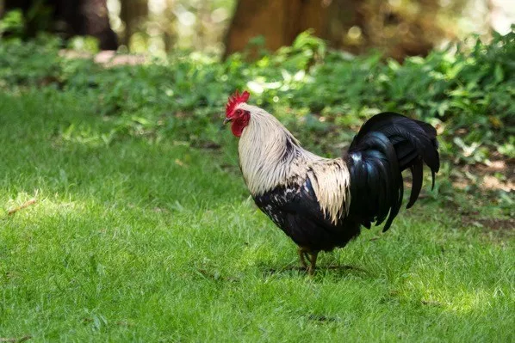
Let’s work through an example!
Question: Do feral chickens affect the survival and growth of endangered tree seedlings on Norfolk Island?

Slide 24
Key points
Observational studies
Evaluating multiple hypotheses can improve strength of inference
Experimental studies
Controls provide a reference point to evaluate the impact of treatments
design should separate treatment and methodological effects

Slide 25
Coming up
Thursday 1pm Workshop: Understanding POWER!!!
Thursday 5pm Lecture (Rich Fuller): Species distributions I
Pre-recorded stats lecture: Hypothesis testing
Friday R Prac: Introduction to hypothesis testing

